Slide 1
Chapter 5
How to use
the CSS box model

Slide 2
Objectives
Applied
Given an HTML document, create CSS style rules that use the CSS box model to apply spacing, borders, and backgrounds to the web page.

Slide 3
Objectives (cont.)
Knowledge
Describe the use of the CSS box model.
Explain how the CSS box model can be used to control the spacing between the headings and paragraphs on a page.
Describe these properties for formatting block elements: height, margin, and padding.
Describe the effect of “collapsed margins.”
Describe the use of a reset selector.
Describe the use of these properties for formatting block elements: border, border-color, and background-color.
Describe these CSS features for formatting block elements: rounded corners, shadows, background gradients.

Slide 4
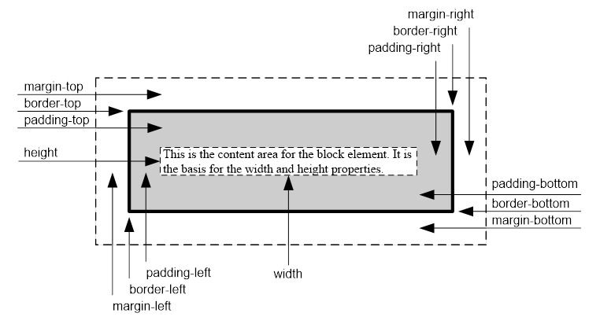
The CSS box model

Slide 5
The formula for calculating the height of a box
top margin + top border + top padding +
height +
bottom padding + bottom border + bottom margin
The formula for calculating the width of a box
left margin + left border + left padding +
width +
right padding + right border + right margin

Slide 6
The HTML for a page that uses the box model
<body>
<main>
<h1>San Joaquin Valley Town Hall</h1>
<p>Welcome to San Joaquin Valley Town Hall.
We have some fascinating speakers for you this
season!</p>
</main>
</body>

Slide 7
The CSS for the page that uses the box model
body {
border: 3px dotted black;
margin: 10px;
}
main {
border: 2px solid black;
width: 500px;
margin: 20px;
padding: 10px;
}
h1, p {
border: 1px dashed black;
padding: 10px;
}
h1 {
margin: .5em 0 .25em;
padding-left: 15px;
}
p {
margin: 0;
padding-left: 15px;
}

Slide 8
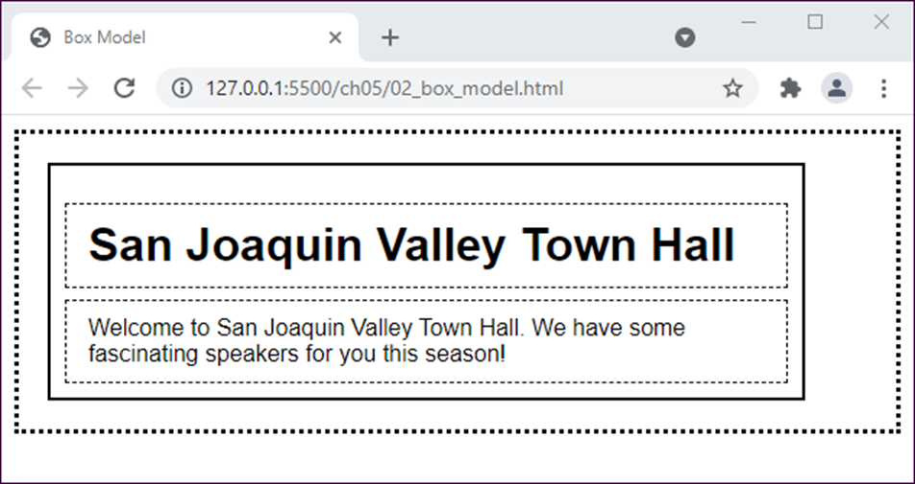
The web page in a browser

Slide 9
How to set the width of the content area
width: 450px; /* an absolute width */
width: 75%; /* a relative width */
width: auto; /* width based on its containing
block (the default) */
How to set the height of the content area
height: 125px;
height: 50%;
height: auto; /* height based on its content (default) */
How to set the minimum and maximum width and height
min-width: 450px;
max-width: 600px;
min-height: 120px;
max-height: 160px;

Slide 10
How to set the margin on a single side
margin-top: .5em;
margin-left: 1em;
How to set the margins on multiple sides
margin: 1em; /* all four sides */
margin: 0 1em; /* top and bottom,
right and left */
margin: .5em 1em 2em; /* top, right and left, bottom */
margin: .5em 1em 2em 1em; /* top, right, bottom, left */

Slide 11
How to set the padding on a single side of an element
padding-top: 0;
padding-right: 1em;
How to set the padding on multiple sides of an element
padding: 1em; /* all four sides */
padding: 0 1em; /* top and bottom,
right and left */
padding: 0 1em .5em; /* top, right and left,
bottom */
padding: 0 1em .5em 1em; /* top, right, bottom, left */

Slide 12

A web page with widths, margins, and padding

Slide 13
The HTML for the page (part 1)
<header>
<img src="images/logo.gif" alt="Town Hall Logo"
width="80">
<h2>San Joaquin Valley Town Hall</h2>
<h3>Bringing cutting-edge speakers to the valley</h3>
</header>

Slide 14
The HTML for the page (part 2)
<main>
<h1>This season's guest speakers</h1>
<nav>
<ul>
<li>October: <a class="date_passed"
href="speakers/brancaccio.html">
David Brancaccio</a></li>
...
<li>April: <a href="speakers/tynan.html">
Ronan Tynan</a></li>
</ul>
</nav>
<h2>Looking for a unique gift?</h2>
<p>Town Hall has the answer. For only $100, ....</p>
<p>Or, for $50, you can give yourself the gift ....</p>
<p>See you at the next show?</p>
<p id="contact_us"><em>Contact us by phone</em> at
(559) 555-1212 for
ticket information.</p>
</main>

Slide 15
The HTML for the page (part 3)
<footer>
<p>&copy; Copyright 2022 San Joaquin Valley Town
Hall.</p>
</footer>

Slide 16
The CSS for the web page (part 1)
body {
font-family: Verdana, Arial, Helvetica, sans-serif;
font-size: 100%;
width: 700px;
margin: 1em auto; }
h1, h2, h3, p {
margin: 0;
padding: 0; }
a { font-weight: bold; }
a:link { color: #931420; }
a:visited { color: #f2972e; }
a:hover, a:focus { color: blue; }
ul { margin: 0 0 1.5em; }
li { font-size: 95%;
padding-bottom: .35em; }
p { font-size: 95%;
padding: .25em 0; }
em { font-weight: bold; }

Slide 17
The CSS for the web page (part 2)
header img { float: left; }
header h2 {
font-size: 220%;
color: #f2972e;
text-align: center;
text-shadow: 2px 2px 0 black;
margin-bottom: .25em; }
header h3 {
font-size: 130%;
font-style: italic;
text-align: center; }

Slide 18
The CSS for the web page (part 3)
main h1 {
font-size: 175%;
margin: 1em 0 .35em;
}
main h2 { font-size: 130%; }
#contact_us { margin-top: 1em; }
a.date_passed { color: gray; }
/* the styles for the footer */
footer { margin-top: 1em; }
footer p {
font-size: 80%;
text-align: right; }

Slide 19

A version of the page that uses a reset selector

Slide 20
The CSS for this version of the page
* {
margin: 0;
padding: 0; }
ul { margin: 0 0 1.5em 1.25em; }
li {
font-size: 95%;
padding-bottom: .35em;
padding-left: .25em; }
#contact_us { margin-top: 1em; }

Slide 21
Properties for setting borders
border
border-side
border-width
border-style
border-color
border-side-width
border-side-style
border-side-color
The syntax for the shorthand border and border-side properties
border: [width] [style] [color];
border-side: [width] [style] [color];

Slide 22
How to set border properties
border: thin solid green;
border: 2px dashed #808080;
border: 1px inset; /* uses the element's color
property */
How to set side borders
border-top: 2px solid black;
border-right: 4px double blue;

Slide 23
How to set the widths of borders
border-width: 1px; /* all four sides */
border-width: 1px 2px; /* top and bottom, right and left */
border-width: 1px 2px 2px; /* top, right and left, bottom */
border-width: 1px 2px 2px 3px; /* top, right, bottom, left */
How to set the style of borders
border-style: dashed; /* dashed line all sides */
border-style: solid none; /* solid top and bottom, no border right and left */
How to set the color of borders
border-color: #808080;
border-color: black gray; /* black top and bottom, gray right and left */
How to set the width, style, and color
border-bottom-width: 4px;
border-right-style: dashed;
border-left-color: gray;

Slide 24
The syntax for the border-radius and box-shadow properties
border-radius: radius; /* applies to all four corners */
border-radius: topLeft topRight lowerRight lowerLeft;
box-shadow: horizontalOffset verticalOffset blurRadius
spread color;

Slide 25
The HTML for a section
<section>
<a href="ebooks_index.html">$10 Ebooks!</a>
</section>
The CSS for the section
section {
padding: 20px;
width: 160px;
border: 5px double blue;
color: blue;
font-size: 200%;
text-align: center;
font-weight: bold;
border-radius: 10px 20px 0 20px;
box-shadow: 3px 3px 4px 4px red;
}

Slide 26

The section in a browser

Slide 27
The properties for setting the background color and image
border
border-side
border-width
border-style
border-color
border-side-width
border-side-style
border-side-color
The syntax for the shorthand background property
background: [color] [image] [repeat] [attachment] [position];

Slide 28
How to use the shorthand property
background: blue;
background: blue url("../images/texture.gif");
background: #808080 url("../images/header.jpg") repeat-y scroll center top;

Slide 29
How to control image repetition
background-repeat: repeat; /* repeats both directions */
background-repeat: repeat-x; /* repeats horizontally */
background-repeat: repeat-y; /* repeats vertically */
background-repeat: no-repeat; /* doesn't repeat */
How to control image position
background-position: left top; /* 0% from left, 0% from top */
background-position: center top; /* centered horizontally, 0% from top */
background-position: 90% 90%; /* 90% from left, 90% from top */
How to control image scrolling
background-attachment: scroll; /* image moves as you scroll */
background-attachment: fixed; /* image does not move as you scroll */
Accessibility guideline
Don’t use a background color or image that makes the text that’s over it difficult to read.

Slide 30
The syntax for using a linear gradient in the background-image property
background-image:
linear-gradient(direction, color %, color %, ... );

Slide 31
The HTML for three divisions
<div id="eg1"></div>
<div id="eg2"></div>
<div id="eg3"></div>
The CSS for the three divisions
#eg1 {
background-image: linear-gradient(
to right, white 0%, red 100%); }
#eg2 {
background-image: linear-gradient(
45deg, red 0%, white 50%, blue 100%); }
#eg3 {
background-image: linear-gradient(
45deg, red 0%, red 33%, white 33%, white 66%, blue 66%, blue 100%); }

Slide 32

The linear gradients in a browser

Slide 33

A web page that uses borders and a gradient

Slide 34
The CSS for the gradient and borders
html {
background-image: linear-gradient(
to bottom, white 0%, #facd8a 100%);
}
body {
font-family: Verdana, Arial, Helvetica, sans-serif;
font-size: 100%;
width: 700px;
background-color: white;
margin: 15px auto;
padding: 15px 1.5em;
border: 1px solid black;
border-radius: 25px;
box-shadow: 5px 5px 0 0;
}

Slide 35
The CSS (continued)
header {
padding-bottom: 1em;
border-bottom: 2px solid #f2972e; }
header h2 {
...
text-shadow: 2px 2px 0 black;
footer {
margin-top: 2em;
border-top: 2px solid #f2972e;
padding-top: .7em; }

Slide 36

Short 5-1 Apply CSS to an HTML page

